Slide 1

Estimates based on Percentiles
Percentiles
More on Percentile
Boxplot
Histogram

Slide 2
Percentiles
A percentile indicates the value below which a given percentage of observations fall.
25th percentile (Q1): 25% of data falls below this point.
50th percentile (median): Half the data is below this point.
75th percentile (Q3): 75% of data falls below this point

Slide 3
More on Percentile…
Percentile Range | What It Tells You
Interquartile Range (IQR) = 75th - 25th percentile | Measures the middle 50% of your data. A large IQR means high spread.
Comparing 90th and 10th percentiles | Gives a broader view of spread across almost the entire dataset.
Outlier Detection | Values below Q1 − 1.5×IQR or above Q3 + 1.5×IQR are likely outliers.
Skewness Indicator | If the 50th percentile is not halfway between 25th and 75th, the data is skewed.

Slide 4
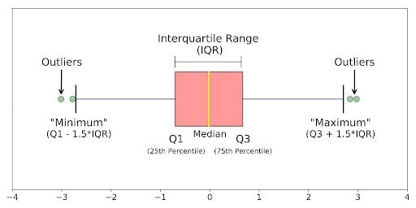
Boxplot
Boxplot are based on percentiles and give a quick way to visualize the distribution of data.

Slide 5
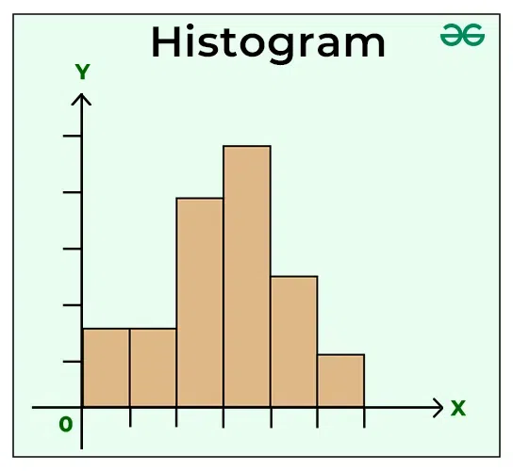
Histogram
A histogram is a way to visualize a frequency table, with bins on the x-axis and data count on the y-axis.
A frequency table of a variable divides up the variable range into equally spaced segments, and tells us how many values fall in each segment.
Empty bins are included in the graph.
Bins are equal width.
Number of bins (or, equivalently, bin size) is up to the user.
Bars are contiguous — no empty space shows between bars, unless there is an empty bin.

